Slide 1


Hello! Instructor introduction
Instructor: Mark Ingram
BSc (IT), MCT, MCSE Cloud Platform and Infrastructure, etc
Trained and / or consulted in 20 countries
Pluralsight author
Four courses—three on SharePoint 2016 and one on Windows 10 Data Security
Notes:
Welcome students to the course and introduce yourself. Provide a brief overview of your background to establish credibility.

Slide 2


Slide 3


Slide 4


Slide 5


Slide 6


Slide 7


Slide 8


Slide 9


Exam Jump Start 70-535 Architecting Microsoft Azure Solutions DevOps and Next Steps
Program Home: https://aka.ms/certup
Content Home: http://github.com/guruskill/70-535
5
Join…
ITProGuru.com/Join
Microsoft Virtual Academy
Notes:
http://aka.ms/certification/70-534
https://mslibrary.measureup.com/

Slide 10
Architect Defined
Given Challenge
<=>
Create Solution
Noun:
1. a person who designs and in many cases also supervises construction
2. the deviser, maker, or creator of anything: the architects of the Constitution of the United States.
Verb:
3. to plan, organize, or structure as an architect: The house is well architected.

Slide 11
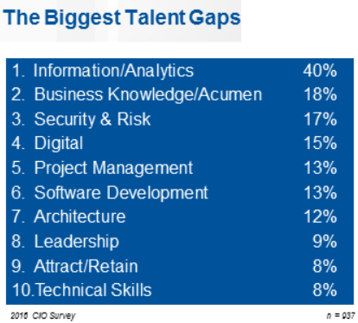

2016 CIO Priorities & Challenges
Talent has now been recognized globally as the single biggest issue standing in the way of CIOs achieving their objectives.
The biggest talent gaps are around Information/Analytics followed by business knowledge/acumen.
Understanding what is possible with the cloud can help close the gap
http://www.gartner.com/imagesrv/cio/pdf/cio_agenda_insights_2016.pdf
Notes:
http://www.gartner.com/webinar/3139617/player?commId=175277&channelId=5500&srcId=1-2973089105

Slide 12


Translate Business Objectives Into Actions
Identify Problems (especially root problems)
Determine the requirements to solve each problem
Determine the best technology options available to help solve the problem
Identify strategic partners
Determine likely barriers
Determine additional value (if any)
Get Started
Notes:
Big picture / micro details

Slide 13
A foundation for Digital Transformation Dave Burnison Technology Solutions Professional - Azure App Dev Dave.Burnison@Microsoft.com
What is DevOps?

Slide 14

“DevOps is the union of people, process, and products to enable continuous delivery of value to our end users.” Donovan Brown Principal Cloud Developer Advocate Cloud Developer Advocacy US @donovanbrown
Notes:
According to Donovan Brown, DevOps is the union of people, process, and products to enable continuous delivery of value to our end users.
You cannot buy DevOps and install it. DevOps is not just automation or infrastructure as code. DevOps is people following a process enabled by products to deliver value to end users.

Slide 15








DevOps is here…
Create
Release
Plan
Configure
DEV
OPS
Package
Monitor
Verify

Slide 16




DevOps is here… and driving business value
Organizations realizing up to 20% improvements in..
Create
Plan
Release
Time-to-market
Configure
Software quality
DEV
OPS
Frequency of deployment
Increased revenue
Package
Monitor
Verify
Customer reach and retention
Source: Global Study by CA Technologies
Notes:
HP firmware story—from one year to a few weeks
700% more time spent on new features and new products

Slide 17
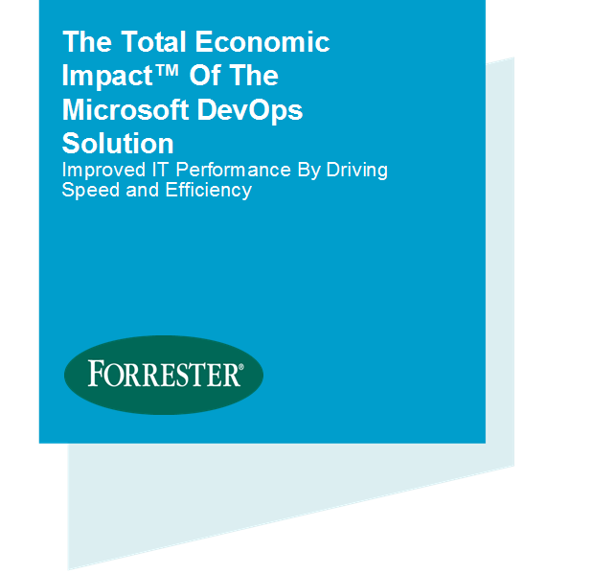
Economic impact summary
$3.9M
NET PRESENT VALUE OVER THREE YEARS
Forrester Consulting, 2016 Based on a composite organization created from surveys and interviews of actual Microsoft customers
529%
three-year, risk-adjusted ROI
80% lower
time to recover from failures
15 times
increase in deployment frequency
3 months
to total payback
Notes:
The economic benefits of DevOps are now universally recognized and accepted.
Organizations that have successfully adopted DevOps …
(Click)
Have seen a 529% ROI over 3 years
(Click)
Have reduced their time to recover from failures by 80%
(Click)
Are deploying their software 15x more frequently
(Click)
And, have seen total payback on these tools and the time spent to implement them in as little as 3 months.
And, Have better morale. Employees in high-performing organizations were 2.2 times more likely to recommend their organization as a great place to work.
As a result, these organizations are able to …
… spend 22% less time on unplanned work/rework, since we have shifted our quality activities to the left in the process
… spend 29% more time on new work, such as new features or code
… experiment in product development, by working in small batches; providing visibility into the flow of work; and gathering customer feedback to iterate.
The Microsoft DevOps solution unlocks DevOps benefits like the ones listed above in record time – investing in DevOps with Microsoft is the easiest way for Enterprise organizations to start their DevOps journey.
Visual Studio Enterprise is at the center of our DevOps solution – if team members are equipped with Visual Studio Enterprise, they have all the tools and services required for modern DevOps.
The total economic impact of the Microsoft DevOps solution
https://info.microsoft.com/the-total-economic-impact-of-the-microsoft-devops-solution.html
C:\Users\daveb\OneDrive - Microsoft\Events\The Total Economic Impact Of The Microsoft DevOps Solution.pdf

Slide 18
DevOps – delivering value in the digital era
22%
29%
50%
75.2x
less time on unplanned work/rework
more time spent on new work
less time remediating security issues
fewer outage costs due to downtime
Employees in high-performing teams are 2.2x more likely to recommend their organization as a great place to work.
Source: 2016 State of DevOps Report (Puppet & Dora), survey of 4,600 technical professionals
Notes:
Digital-minded organizations are adopting DevOps practices as the vehicle for delivering transformation, and are reaping the benefits from doing so.
High-performing organizations spend 22 percent less time on unplanned work and rework. As a result, they are able to spend 29 percent more time on new work, such as new features or code. They are able to do this because they build quality into each stage of the development process through the use of continuous delivery practices, instead of retrofitting quality at the end of a development cycle.
High performers spend 50 percent less time remediating security issues than low performers. By better integrating information security objectives into daily work, teams achieve higher levels of IT performance and build more secure systems.
And a final differentiator – by adopting DevOps standards and practices, employees are 2.2x more likely to recommend their organization as a great place to work.
Source: 2016 State of DevOps Report (Puppet & Dora), survey of 4,600 technical professionals

Slide 19



Tools for any Developer
Code
Team Services
Team Foundation Server
For Mac
Windows
Linux
iOS
Android
.NET C#
C++
JavaScript
PHP
Python
Node.js
R
Cordova
Unity
Java
Perl
Xamarin
PowerShell

Slide 20
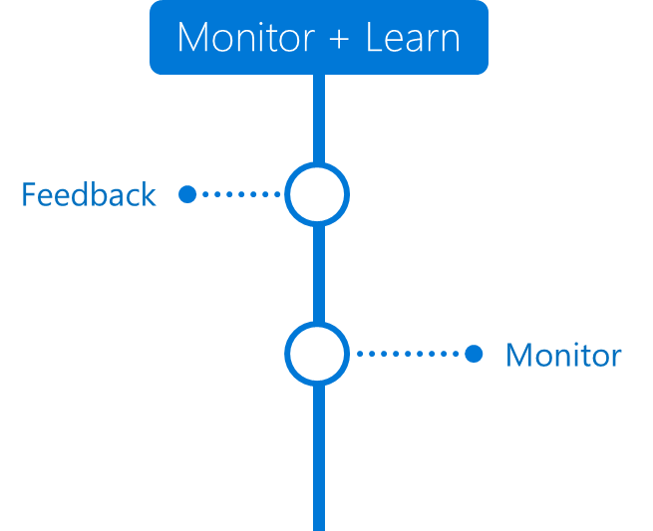



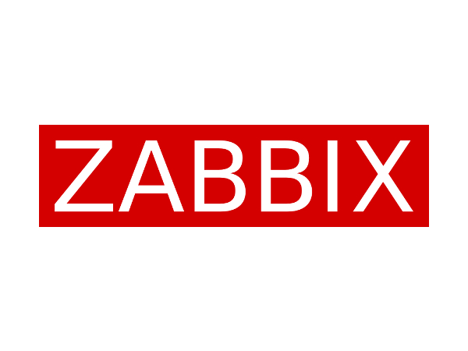
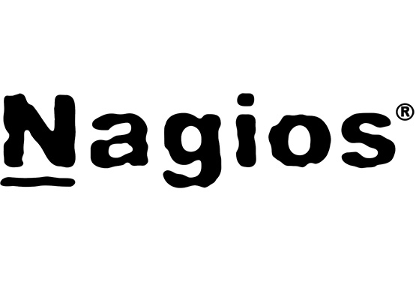
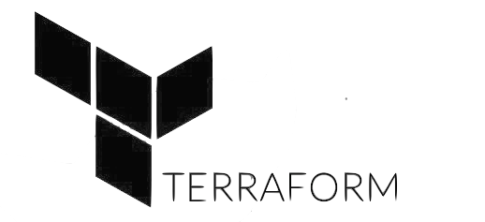
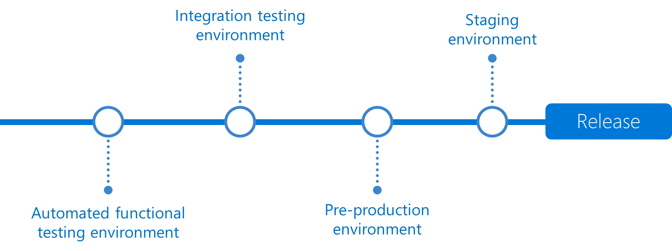
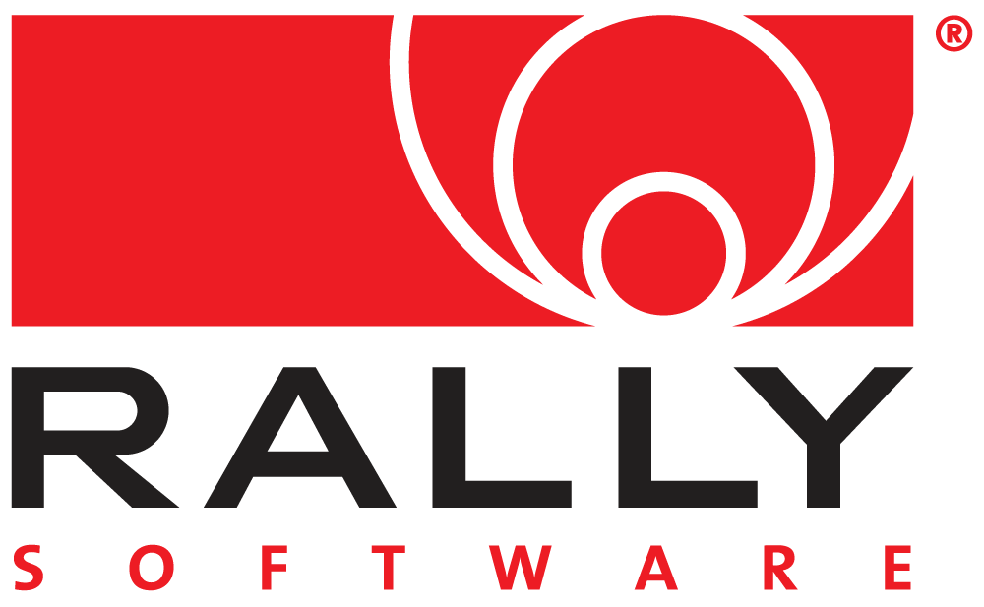



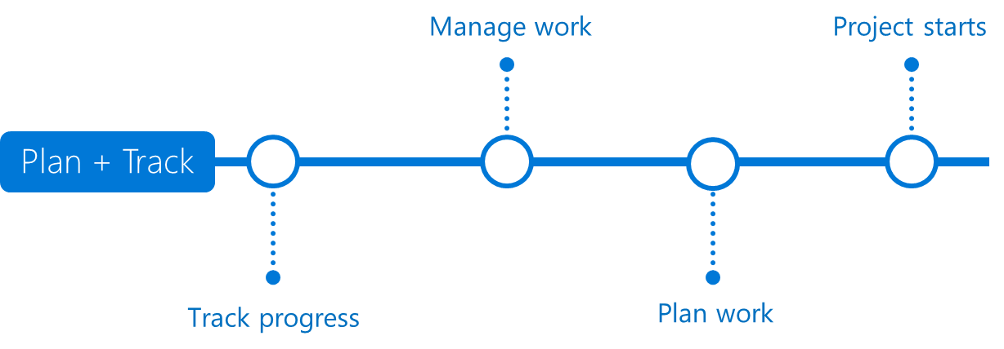

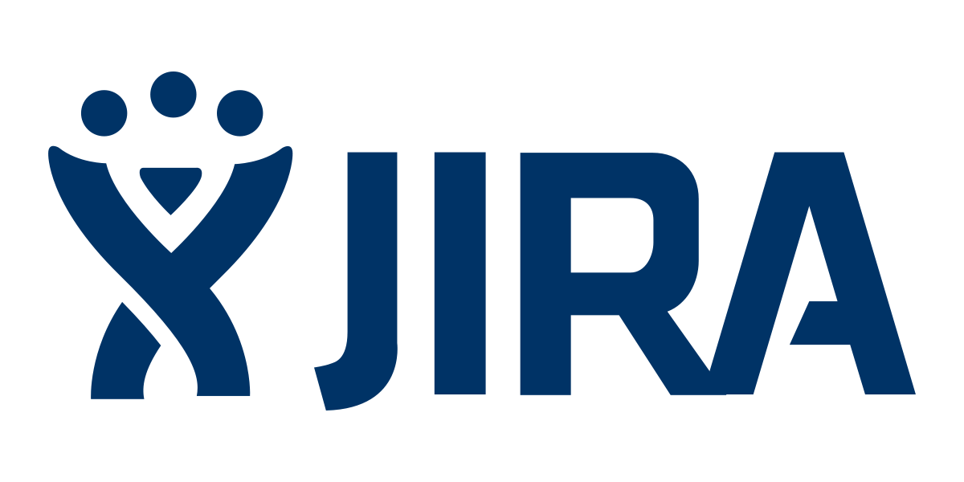

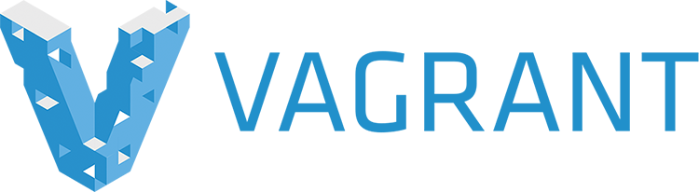



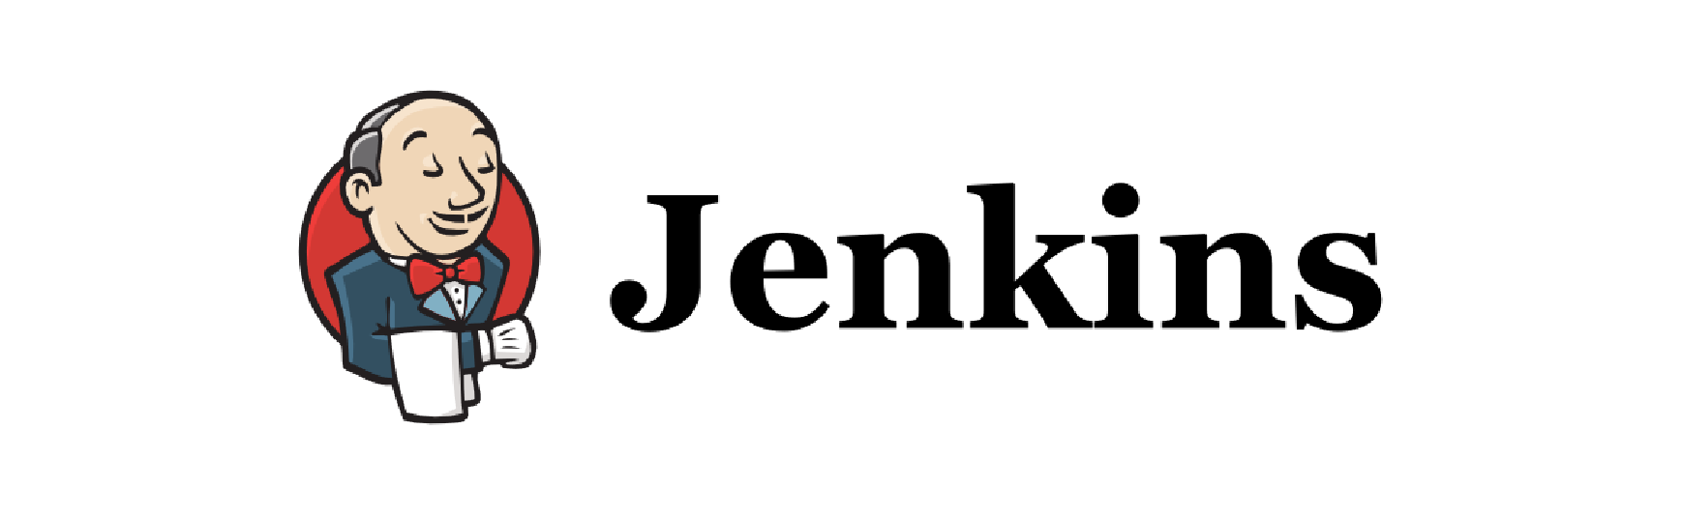

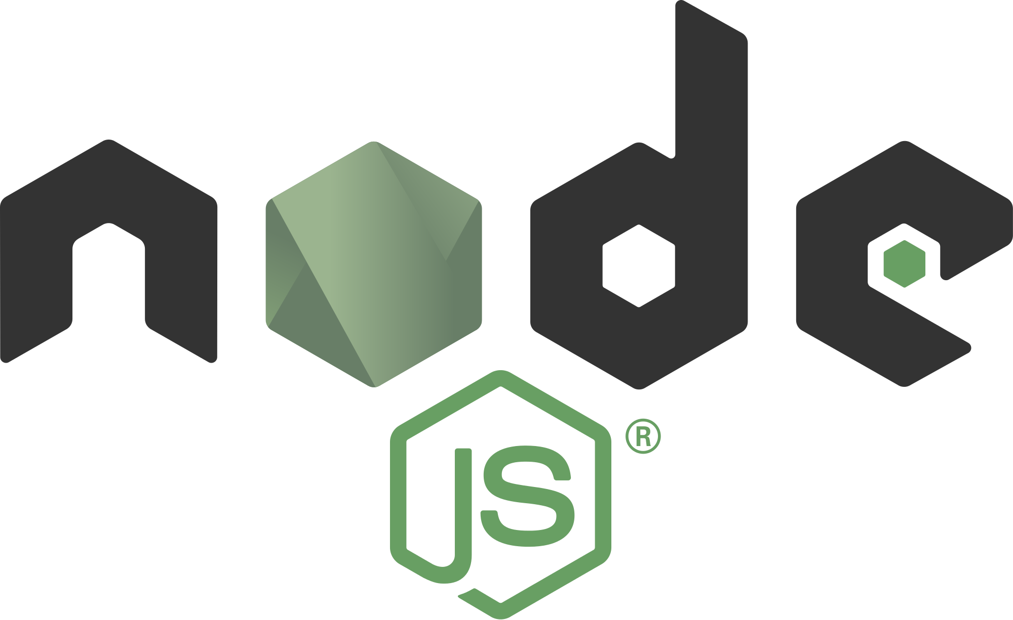
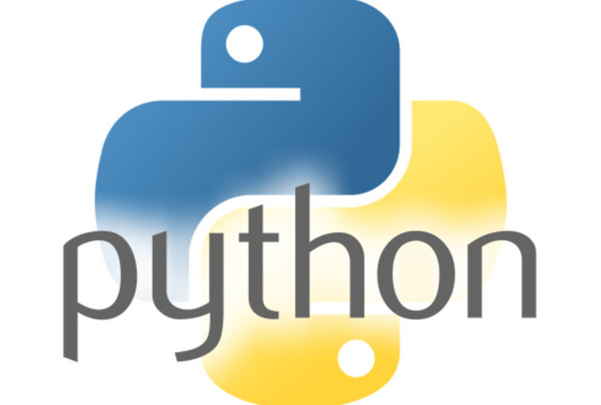
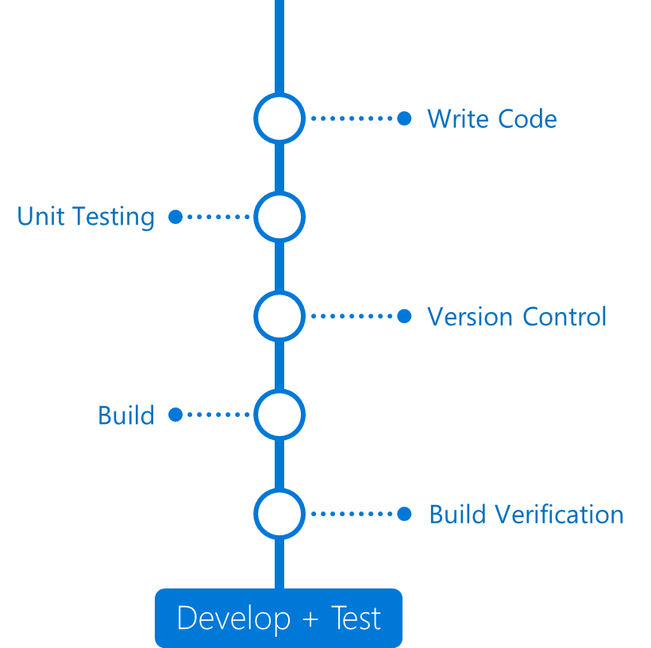

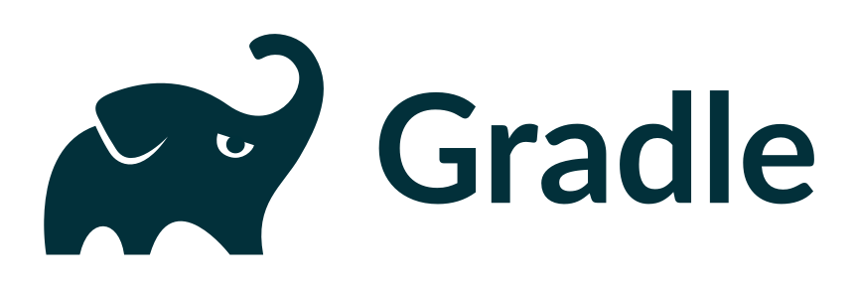

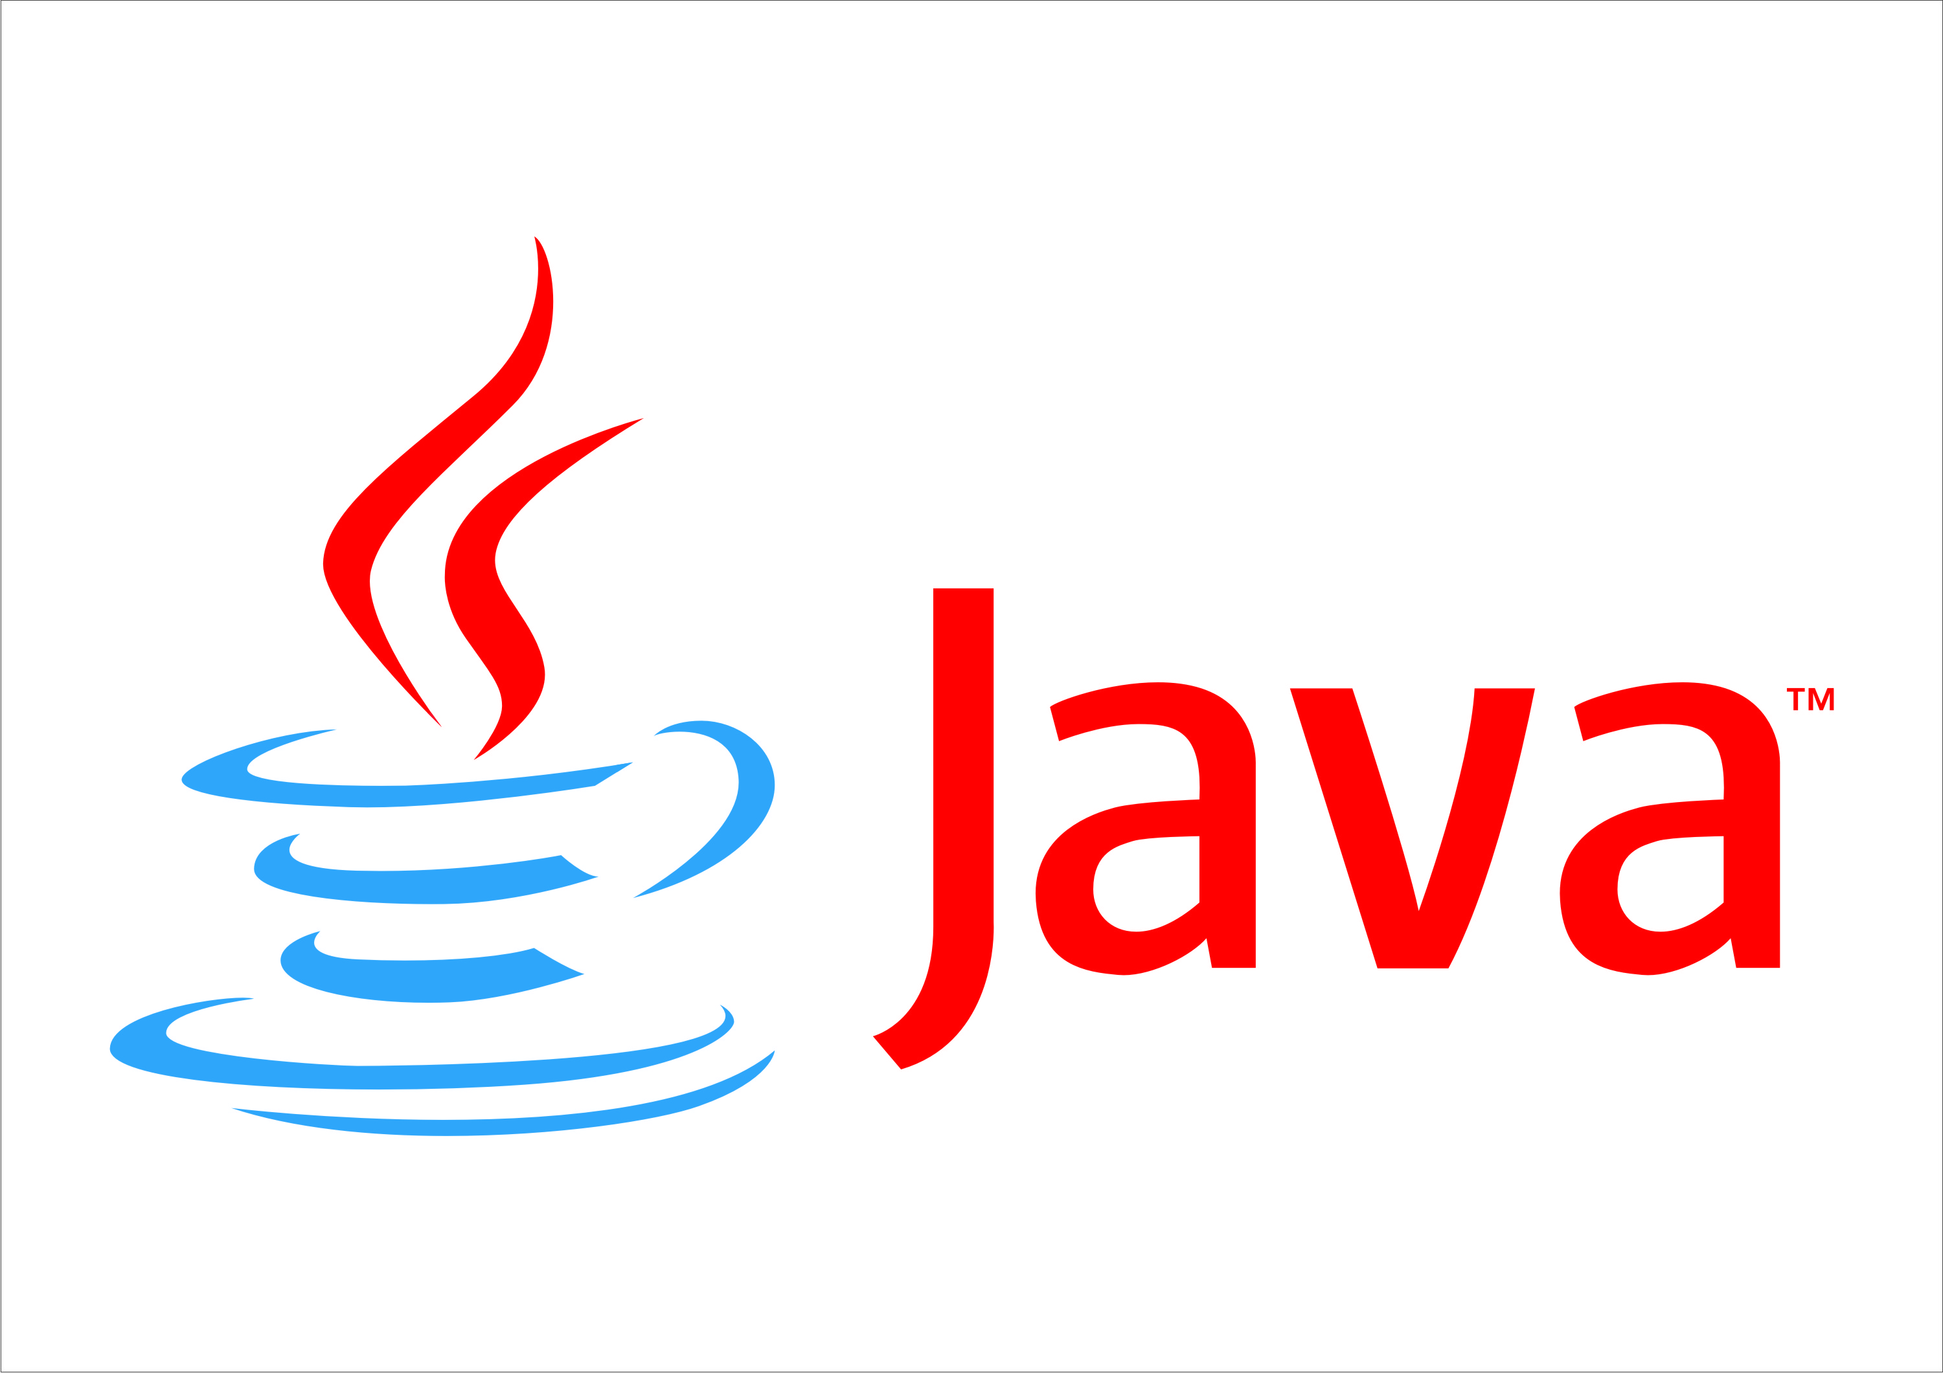
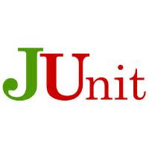
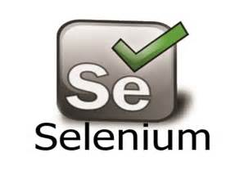
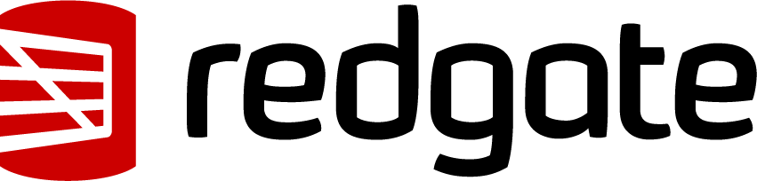
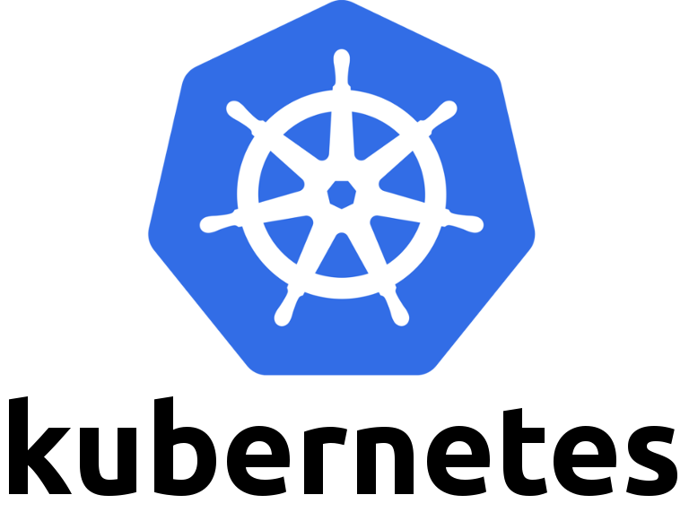

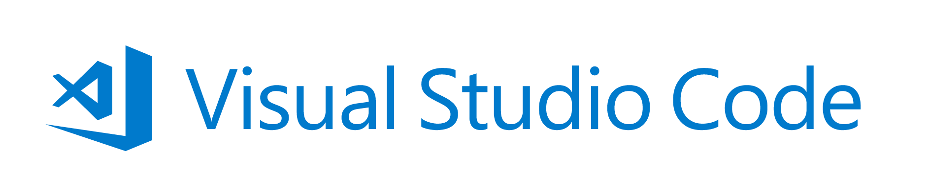

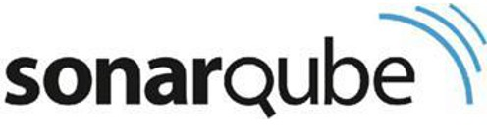

DevOps with VSTS
DevOps
DevOps is the union of people, process, and products to enable continuous delivery of value to our end users.
Application Insights
DevOps
DevOps
Visual Studio
Notes:
Continuously delivering value is about more than just automating deployments. You must start at the beginning of your development process - what you plan to deliver and how you plan to get there. In other words, planning and tracking.
[CLICK – Transition slide to show Planning phase]
Your project starts with an idea and a plan how to turn this idea into reality.
Agile approaches software development by emphasizing incremental delivery, team collaboration, continual planning, tracking and learning.
​
[CLICK – Transition slide to show development and test phase]
Although planning starts the process, the development team turns the ideas into features and capabilities during the development and testing phase.
Your development team will use the practice of continuous integration to merge code and automatically run a build process, including tests, whenever they commits a code change. ​
​
[CLICK – Transition slide to show release]
Continuous delivery will deploy your build to testing, pre-production, staging, and other environments in the release process.
It gives you quality gates throughout your release pipeline and increases confidence in your code long before production. ​
​
[CLICK – Transition slide to show monitor]
Lastly, you need to watch your solution in production. Effective monitoring delivers information about your solution’s performance, usage, and issues.
It’s essential to enable DevOps teams to deliver at speed, get feedback from production, and increase customers satisfaction, acquisition and retention.​
[CLICK – Transition slide to show other products and end with VSTS]
​Whether you are targeting the cloud, hybrid cloud, or an on-prem environment, Visual Studio Team Services, or VSTS, is the recommended Azure DevOps solution.
It allows you to plan, monitor, build and deploy to Windows, Unix, Android, or iOS, from .NET, Java, PHP, Python, Ruby, C++, and many other 3rd party and open source products such as Ant, Maven, Gradle, Junit, NUnit, xUnit, and Jasmine.
If you cannot find a task needed for your release pipeline, you can build custom tasks that integrate with VSTS and your continuous integration and continuous deployment.

Slide 21
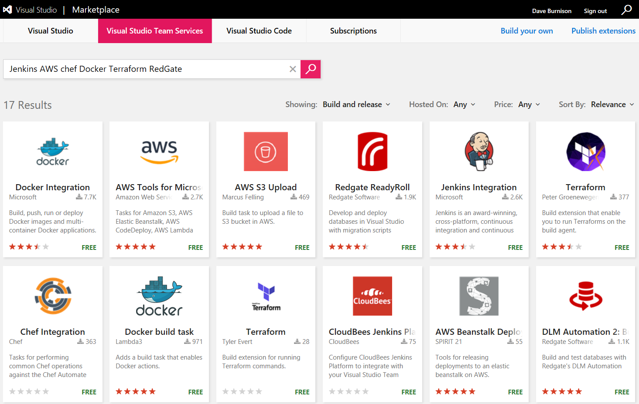
Get 3rd Party Extensions in the VSTS Marketplace
Notes:
Free and Paid extensions.
Jenkins AWS Chef Docker Terraform RedGate

Slide 22
Demo

Slide 23

DevSecOps: Security embedded in DevOps
OSS Vulnerabilities
WhiteSource**
Container Security
Aqua**
Static Analysis Security Testing (SAST)
OWASP
SonarQube
AttackFlow
Brakeman
CPPCheck
LAPSE
.NET Security Guard
Coverity*
Parasoft**
VeraCode**
Fortify*
Checkmarx**
* - A commercial brand covering related security products
** - A company selling a security products
This Photo by Unknown Author is licensed under CC BY-SA

Slide 24
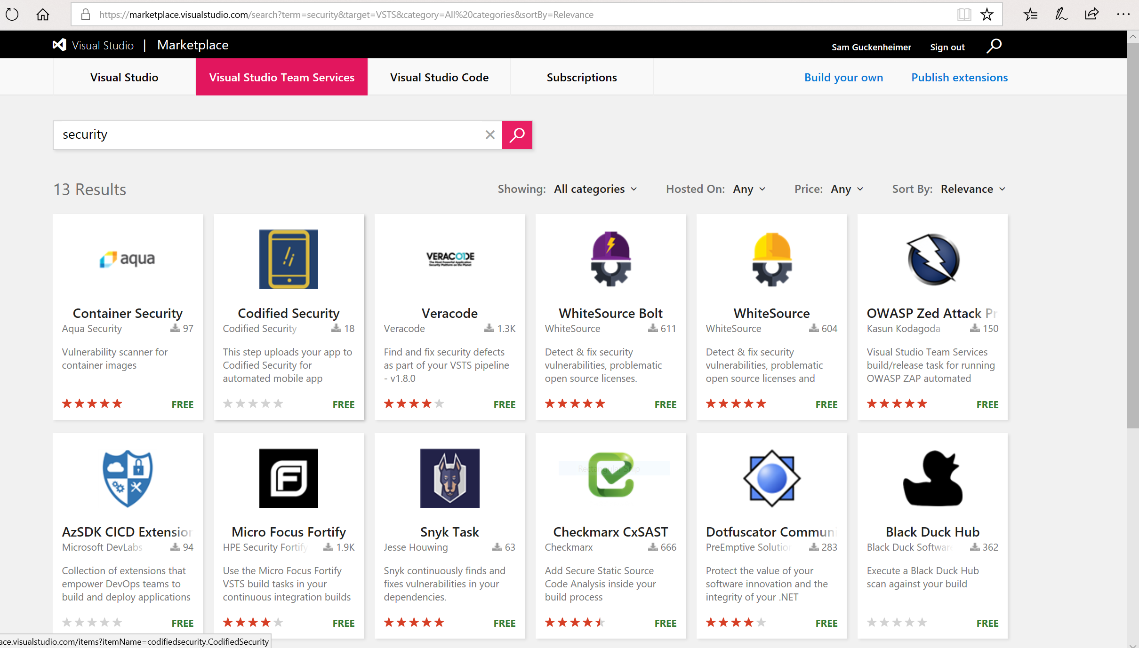
Notes:
https://marketplace.visualstudio.com/vsts

Slide 25
Roles and Responsibilities
Security - Incorporate security necessities into every aspect of the business; enable others to automate compliance
Development – Quickly build, deploy & update a product that our customers love; Enable other groups by building what they need to support you.
IS/IT – Build infrastructure as code; enable others by helping to eliminate waste throughout the technology landscape
Management – Enable the teams by giving them flexibility, guidance and support to do what is needed; remove obstacles
Senior Management – Embrace Cultural Change; Drive Transformation in the organization.
Everyone – Help build a product that will inspire our customers to become raving fans
Notes:
Security - Help find a way to incorporate security necessities into every aspect of the business; without getting in the way unnecessarily
Gerry McGovern—top task management

Slide 26


Use and orchestrate your favorite 3rd party tools. Your toolchain, seamlessly integrated with Azure.
“Azure support for Docker, Kubernetes, Puppet, Terraform, Cassandra, and other open source tools has become very important to us and has really accelerated our move into Azure.” – Robert Rudduck, Director of Architecture and DevOps Read the story
Notes:
Key quote:
The CI/CD process includes Infrastructure as Code, which allows security, networking, storage and compliance to be part of the development life cycle. When code is ready to deploy, it and the infrastructure on which it will run are deployed in tandem. Developers define the entire infrastructure using Azure platform services and open source tooling—Azure Resource Manager, Puppet, Terraform, and Microsoft Visual Studio Team Services.
Continuous integration / Continuous delivery

Slide 27
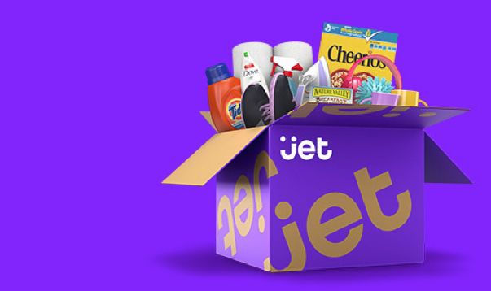
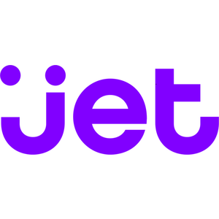
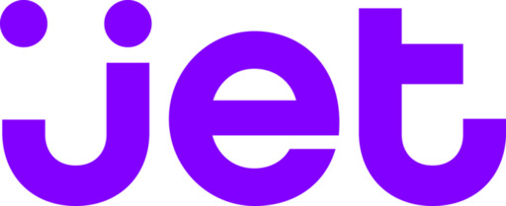
Spend less time building delivery pipelines and more time delivering software
E-commerce challenger eyes the top spot, simplifies development and delivery with DevOps on Azure “Being able to leverage so many off-the-shelf services and tools from Azure enabled us to go from zero to a full- fledged e-commerce marketplace in just about 12 months.” – Mike Hanrahan, CTO Read the story
Simple
“Being able to leverage so many off-the-shelf services and tools from Azure enabled us to go from zero to a full-fledged e-commerce marketplace in just about 12 months.” – Mike Hanrahan, CTO
Read the story
Notes:
Key quote:
The Microsoft Visual Studio development system is the primary IDE for back-end infrastructure, with Node being used on the front end. To get its code through development and into production as fast as possible, Jet uses a mix of Azure App Service, Azure Web Roles and custom servers, with deployment happening from Jenkins.

Slide 28


Deploy continuously and compliantly to enterprise-grade cloud services, with integrated security and monitoring.
“With DevOps and Azure, we’re able to reduce our new-feature release cycle down to one week, and we think we can even speed that up.” – Fikri Larguet, Director of Cloud Services
Read the story

Slide 29
Resources

Slide 30
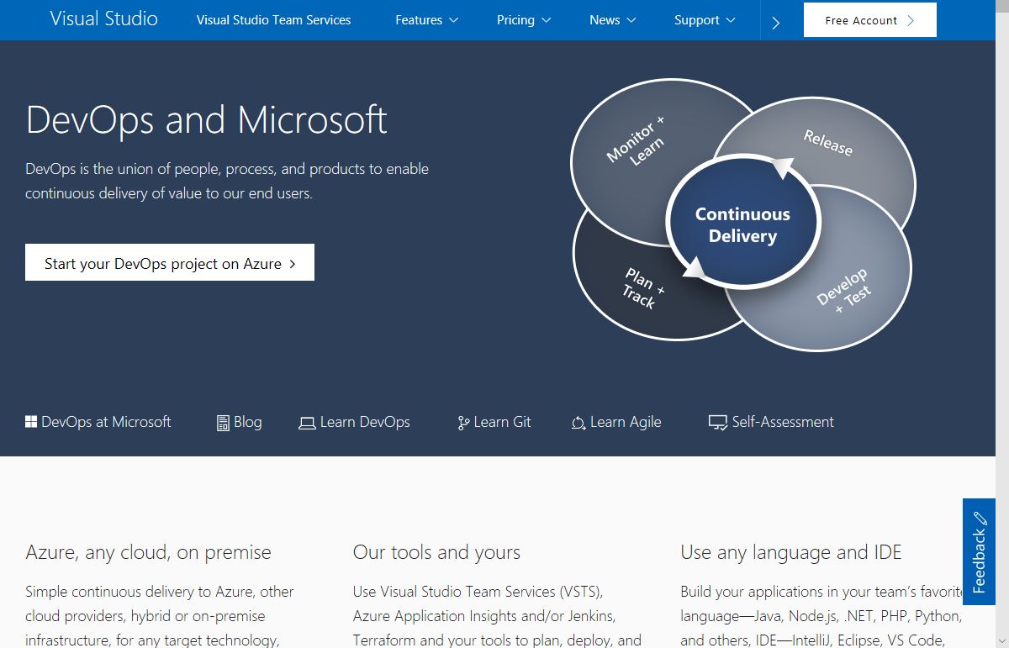

Slide 31
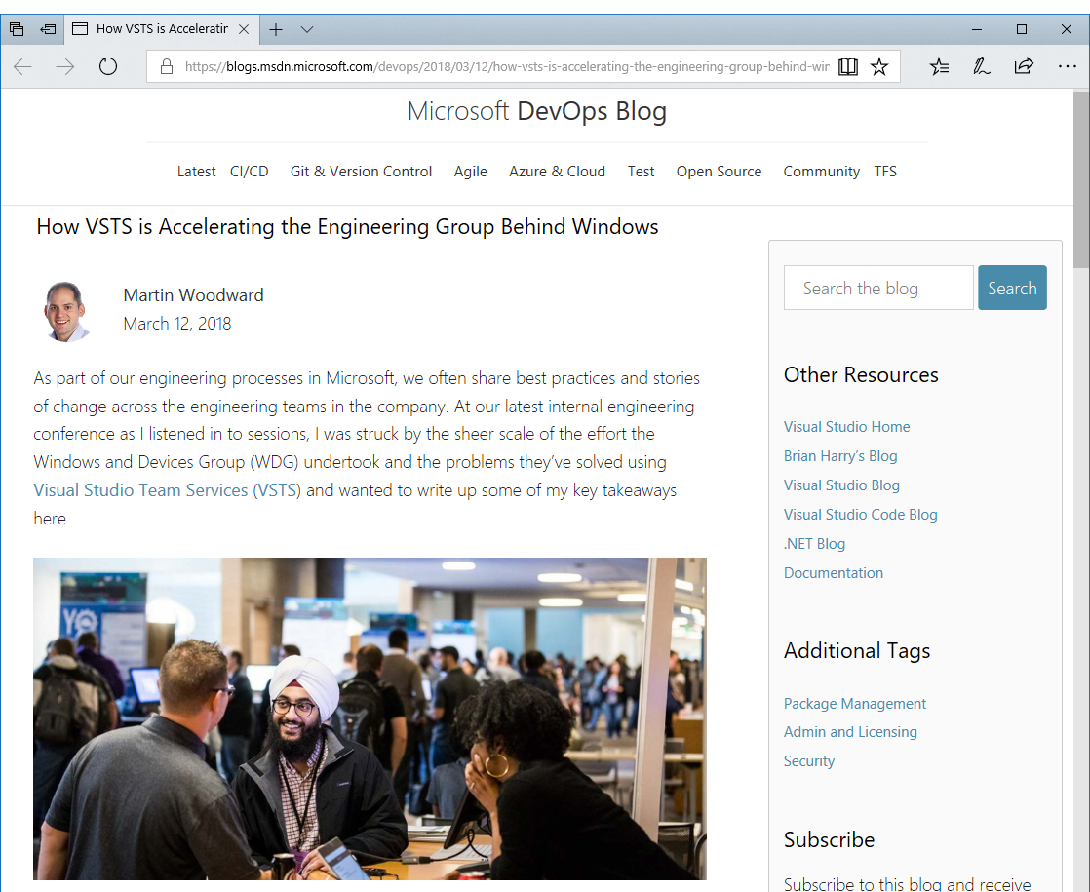
How VSTS is Accelerating the Engineering Group Behind Windows:
“With over 22,000 employees and 7,000 software developers in the group, it’s larger than many companies”
“The recent Fall Creators Update to Windows 10 consisted of around 4 million individual commits grouped into around 500,000 pull requests. All changes to the Windows code are reviewed via pull requests which has proven to be the best way to work in any Git team in Microsoft. It has taken significant engineering work to build a pull request system in VSTS that is able to handle pull requests at the scale of a group like WDG”
“WDG also puts a similar level of demand on the VSTS work tracking system. They currently have over 10 million work items tracking bugs, features and tasks etc”
“The WDG team has seen massive improvements in moving to VSTS, not just in pure throughput, but also in the satisfaction levels of engineers on the team. Engineer satisfaction is the one of the most important management metrics for WDG. This also reflects the change of culture not just in their group but also across Microsoft as a whole towards rewarding sharing and reuse”
“It’s been an incredible four years; we’ve come further than we could have imagined together through the power of DevOps and the benefits of encouraging a culture of sharing inside and outside the company.”
Notes:
Windows and Devices Group

Slide 32
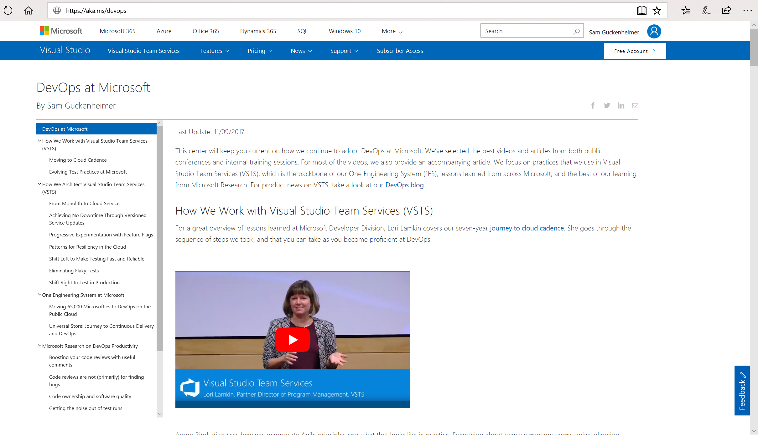
Share http://aka.ms/DevOps with your team:
Create a series of “Lunch & Learn” sessions based on our DevOps journey. At each session watch one video and have a follow up discussion with your team.
Or, treat it like a book club, i.e. have everyone watch a video and read the related narrative as an assignment, then have a discussion session over lunch.
Either way, discuss with your team what is/is not applicable to your company, (or, what should be applicable in the future).

Slide 33
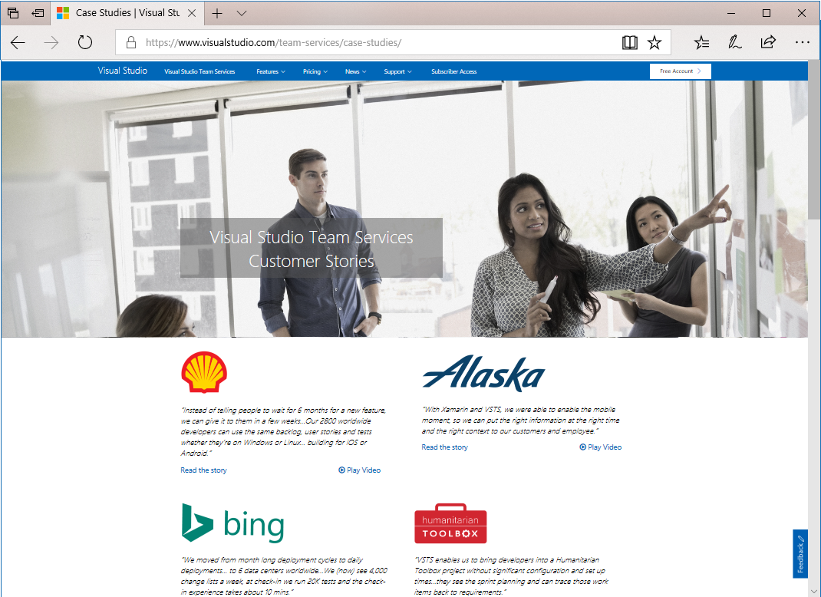
How are other customers continuously delivering value to their end users with DevOps? Check out our VSTS Customer Stories:
https://www.visualstudio.com/team-services/case-studies/

Slide 34
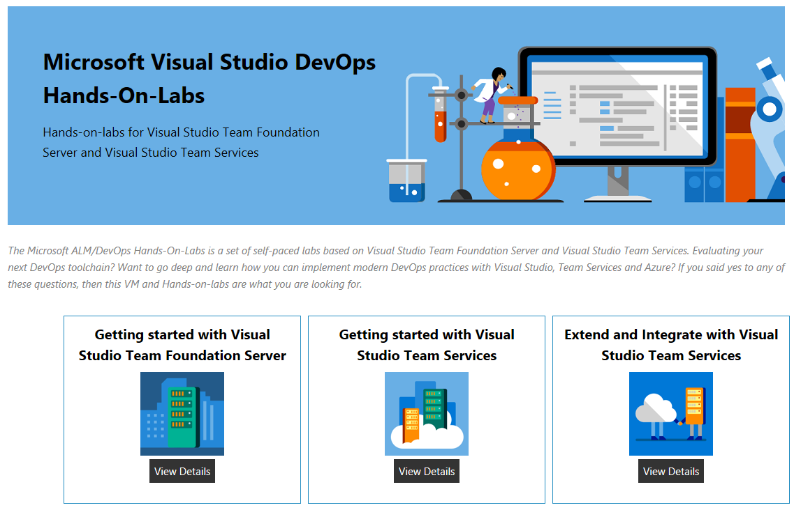

Slide 35
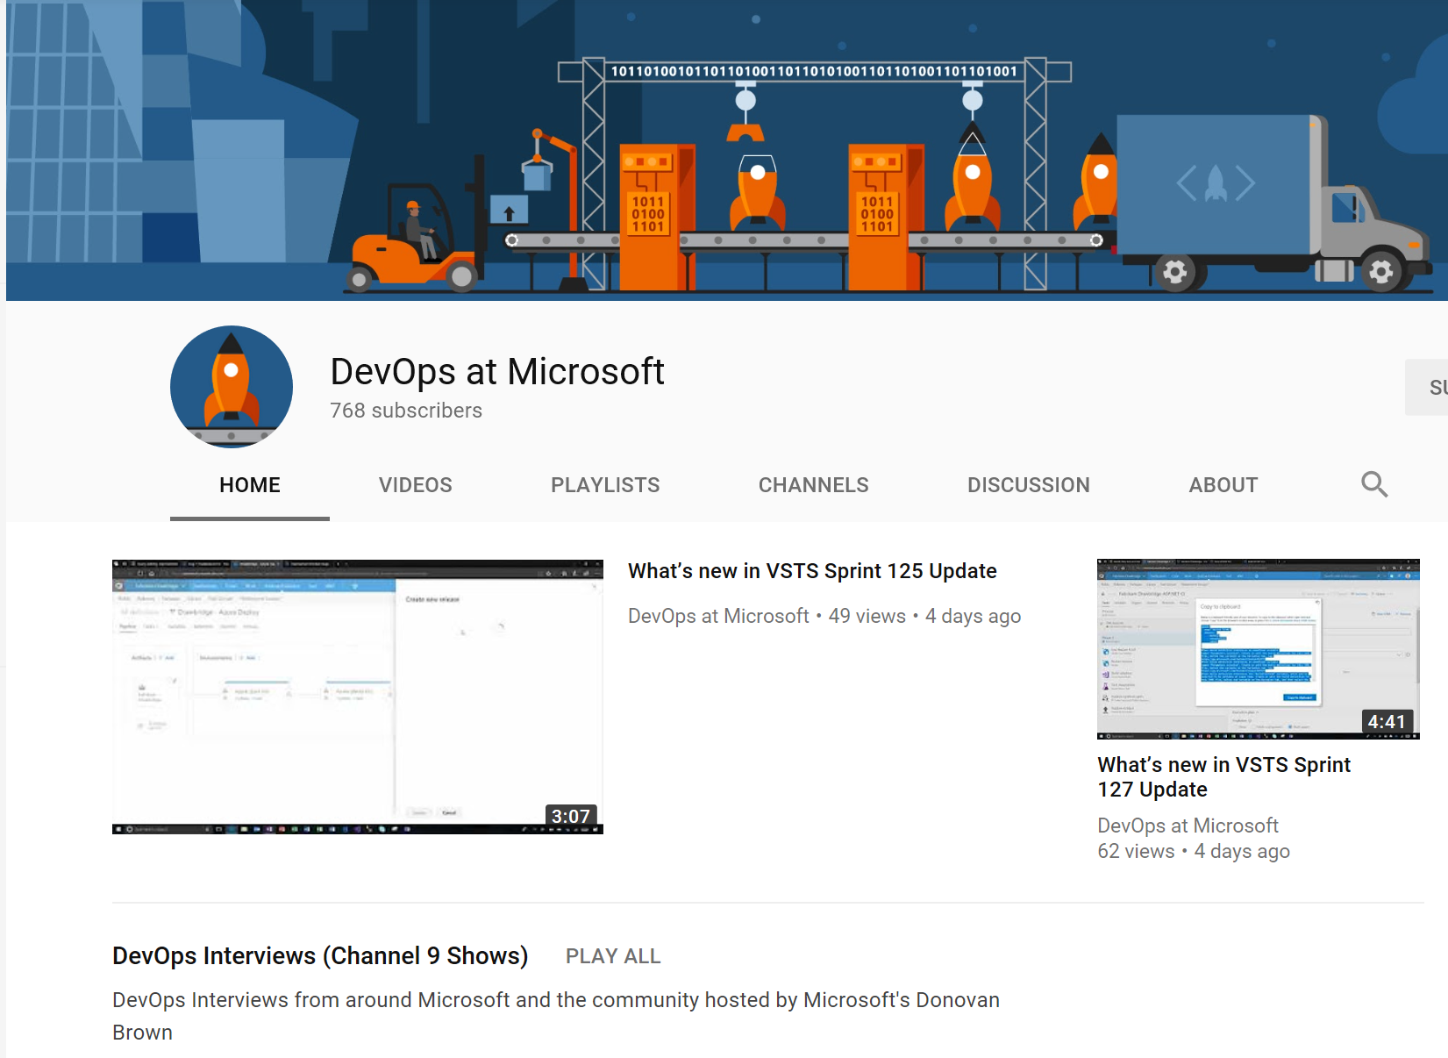
Subscribe to the ”DevOps at Microsoft” YouTube channel
Notes:
TAKE A PICTURE OF THIS SLIDE!

Slide 36
Resources What is DevOps? https://ptdrv.linkedin.com/2x6qwb3 Learn DevOps https://ptdrv.linkedin.com/5ljn2ey
Notes:
TAKE A PICTURE OF THIS SLIDE!

Slide 37

Tip: Must Read Book
Amazon…
The Phoenix Project: A Novel about IT, DevOps, and Helping Your Business Win (Paperback)
– October 16, 2014
The book is available on Audio Book; you can likely get it for free, if you do not already have an account. If you do not have an Audible Account, you get two free books when signing up for your free account.
Notes:
TAKE A PICTURE OF THIS SLIDE!
https://www.amazon.com/Phoenix-Project-DevOps-Helping-Business-ebook/dp/B00AZRBLHO

Slide 38

Questions?
Dave Burnison Dave.Burnison@Microsoft.com

